Slide 1
Assignment 2
BIOL5488
1/23/2026
Adapted from 2023/2024 TAs

Slide 2
Preliminary Work (detailed in Assignment2.md)
Modify the .bashrc file to initialize conda environment.
cd ~ # go to your the home folder
vim .bashrc
Specify working path for Docker container
$ export LSF_DOCKER_VOLUMES='/storage1/fs1/workshops/Active/BIO5488/SP2026.L41.BIOL.5488.01/Assignments/A02/Users/<username>:/storage1/fs1/workshops/Active/BIO5488/SP2026.L41.BIOL.5488.01/Assignments/A02/Users/<username>'
Create docker container.
bsub -Is -q workshop-interactive -G compute-workshop -a 'docker(takinwe1/bio5488:0.0)' /bin/bash
Activate conda environment from your working directory
conda activate bio5488
cd /storage1/fs1/workshops/Active/BIO5488/SP2026.L41.BIOL.5488.01/Assignments/A02/Users/<username>/

Slide 3
Main Goal: Align reads to Chr22 with Bowtie2

Slide 4
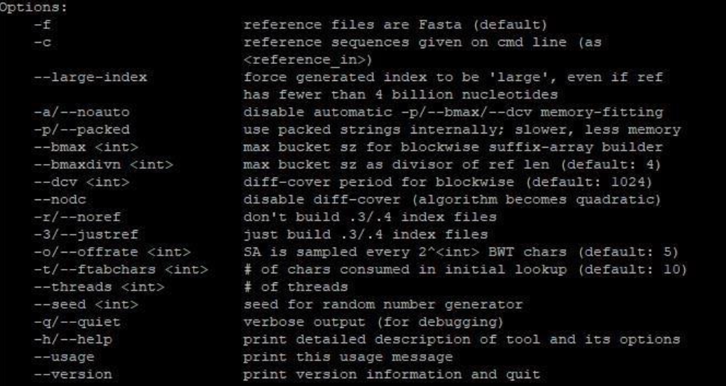
1st Step: Create index for Chr22
Genome indexing stores the context of the genome to make searching more efficient.
Bowtie2 is a tool used to align short DNA sequencing reads to a larger reference genome.
Aims:
Use bowtie2-build: creates various files with different file extensions.
  Use $ bowtie2 –h to learn about various options to map sequencing reads.
  Can also find more information on: https://bowtie-bio.sourceforge.net/bowtie2/manual.shtml

Slide 5
2nd Step: Align with Bowtie2
Align reads from reads.fq (found in /storage1/fs1/workshops/Active/BIO5488/SP2026.L41.BIOL.5488.01/Assignments/A02/Assignment_Data)
Things to note when running bowtie2:
  reads.fq has unpaired reads
  Alignment output and report output should be saved to a file

Slide 6
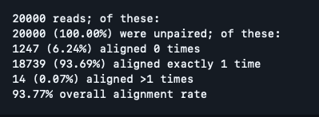
Requirements
Alignment output should be saved in a SAM (sequence alignment format)
Report file should have alignment summary
Expected Output Summary

Slide 7
What to turn in
Output files
Alignment file
Report file
README.txt with answers to questions and commands used to answer the questions.

